Slide 1
Language translator
Computer Science & Engineering Artificial Intelligence and Machine Learning By
Tulsi Dubey (22106055)
Pranav Jain (22106069)
Vrushabh Jain (22106120)
Sanika Jawane (22106052)
Under the Guidance of Prof. Sayali Sonje

Slide 2
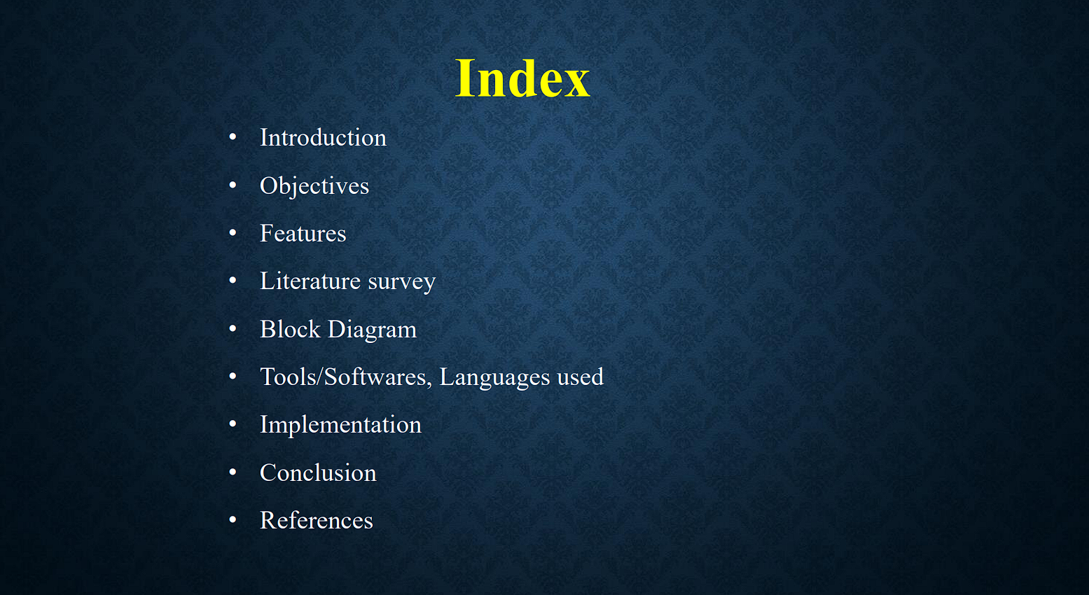

Slide 3
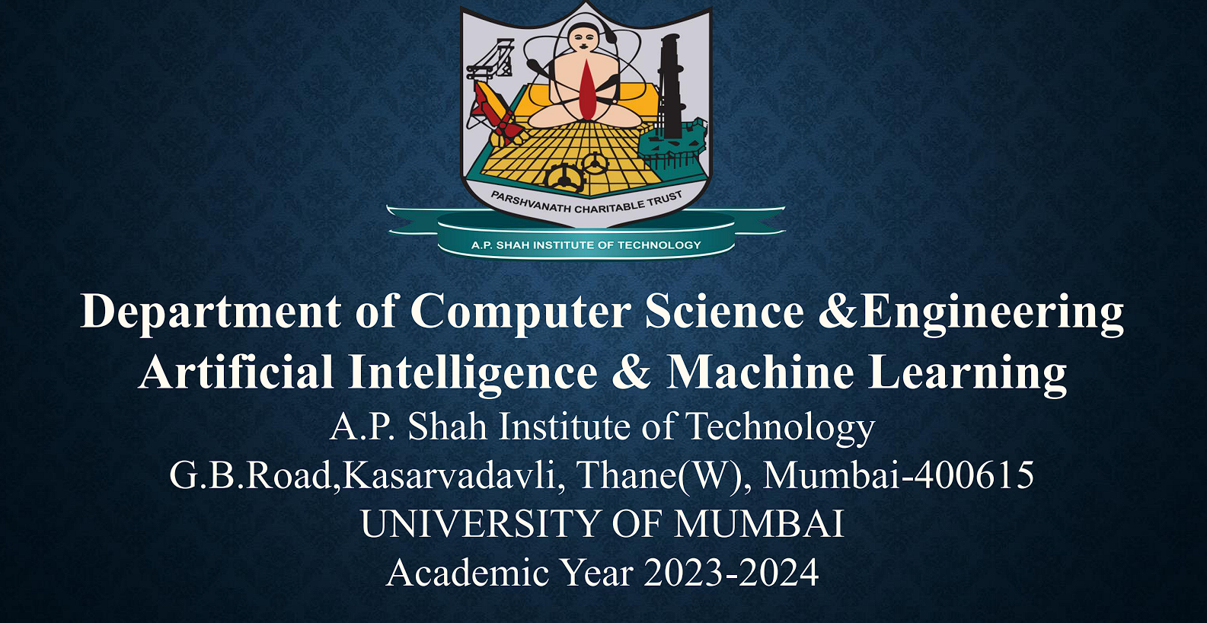
MINI PROJECT
Sanika Jawane (39)
Vrushabh Jain (38)
Tulsi Dubey (24)
Pranav Jain (37)

Slide 4
introduction
Introducing our language translator app, seamlessly crafted with the power of Java and Python.
Break down language barriers effortlessly and communicate effortlessly with the world.

Slide 5
OBJECTIVE
Our goal is to create a user-friendly language translator app, leveraging the capabilities of Java and Python, to empower individuals worldwide to bridge communication gaps, fostering understanding and connectivity across diverse cultures and languages.

Slide 6
BLOCK diagram

Slide 7
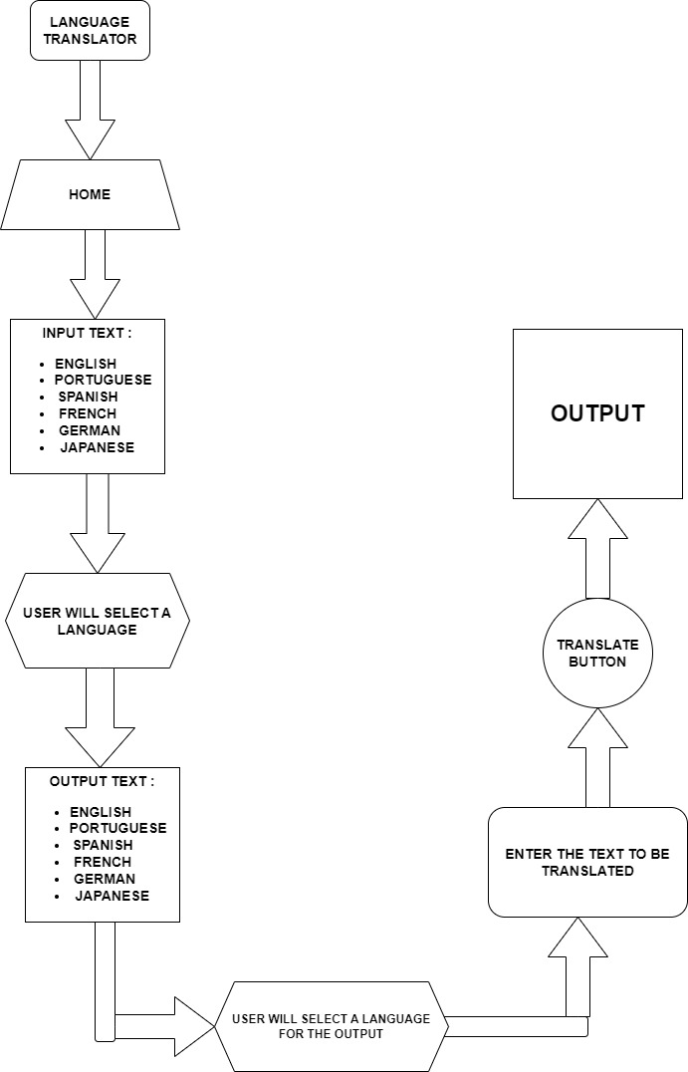

Slide 8
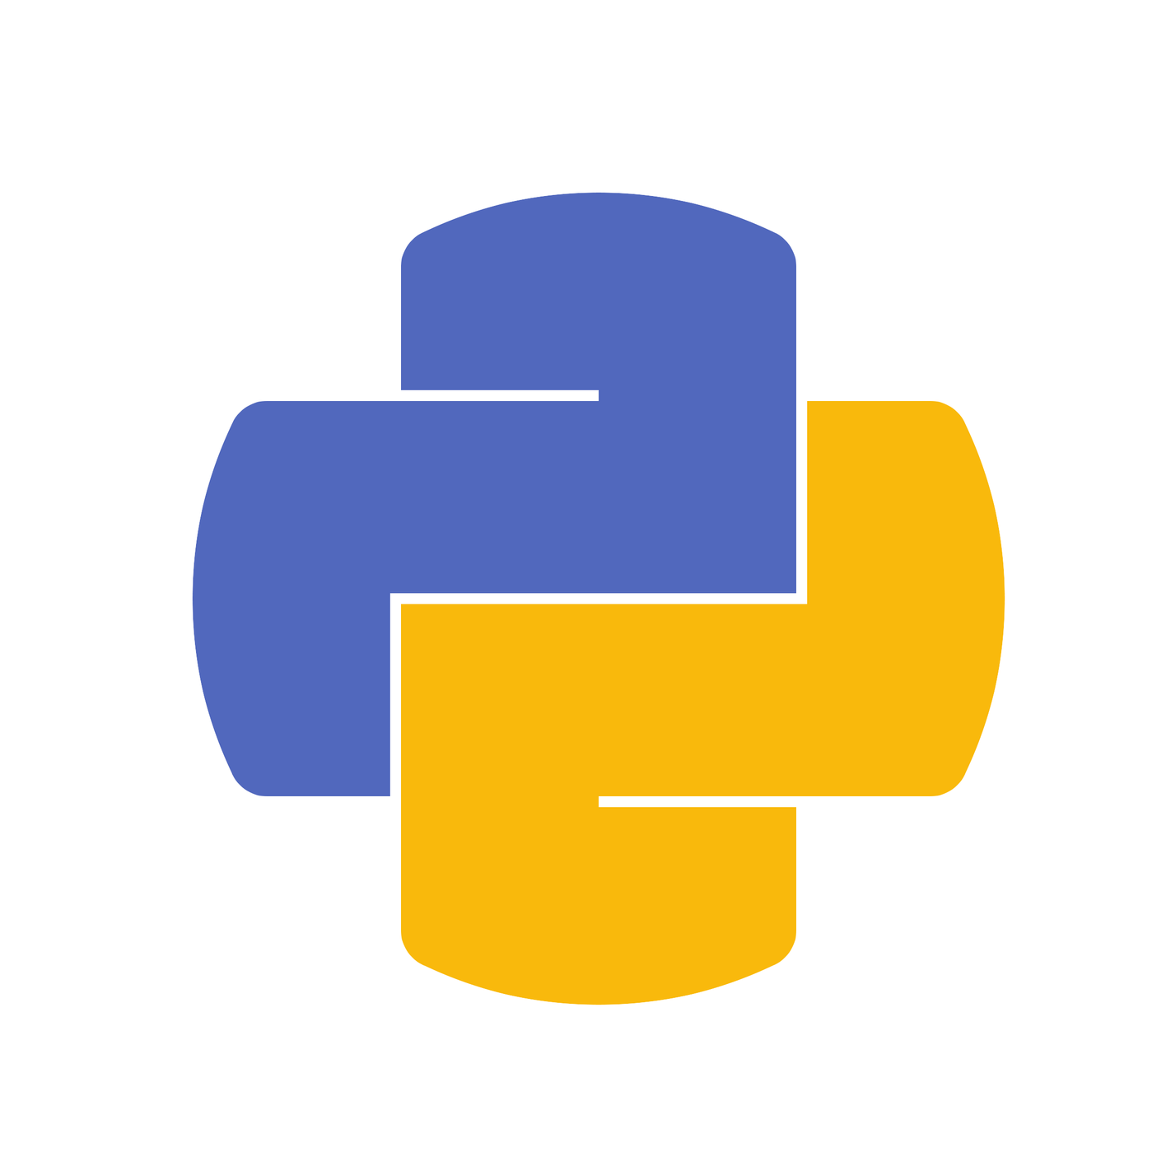
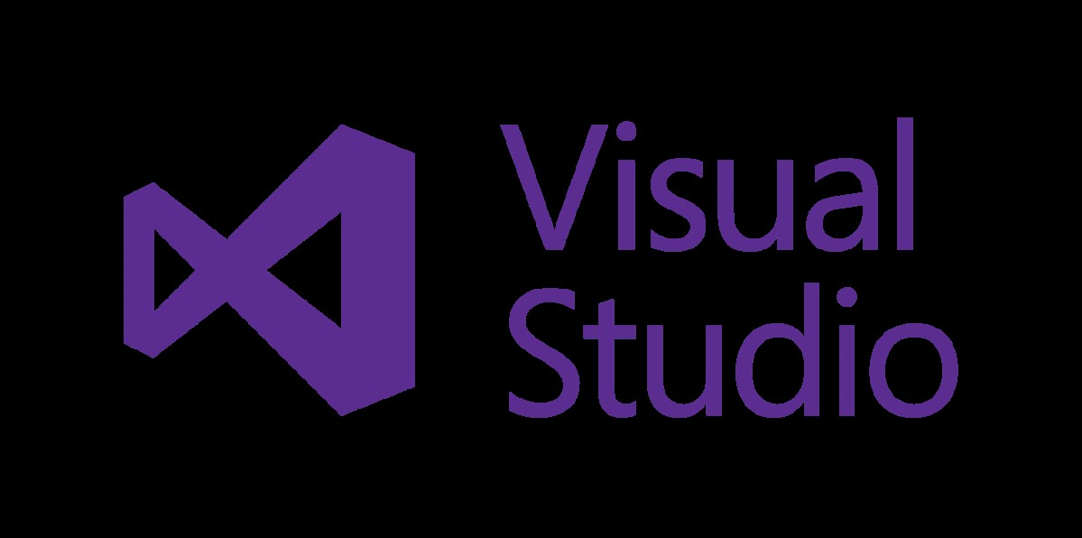
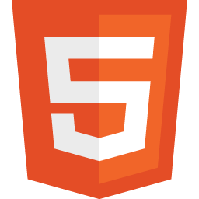
SOFTWARE/ LANGUAGE USED
VISUAL STUDIO
HTML
PYTHON

Slide 9

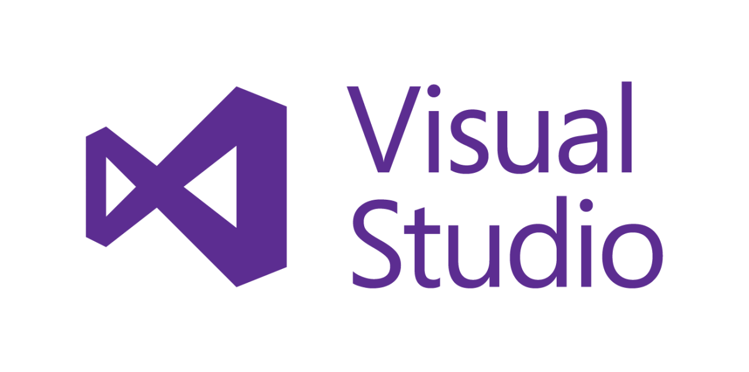

Slide 10
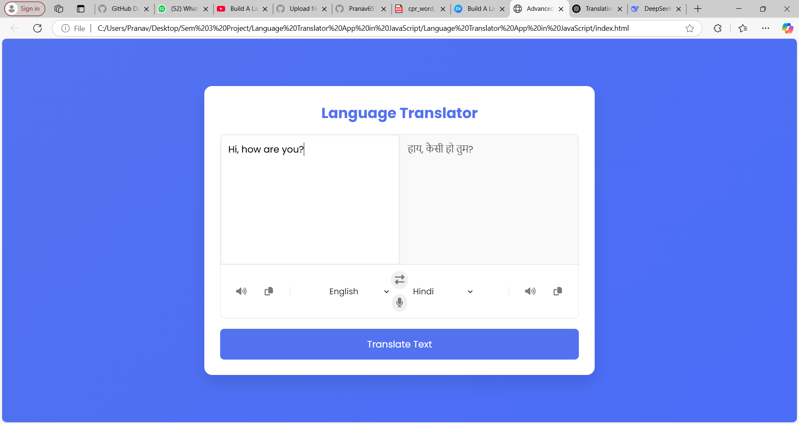
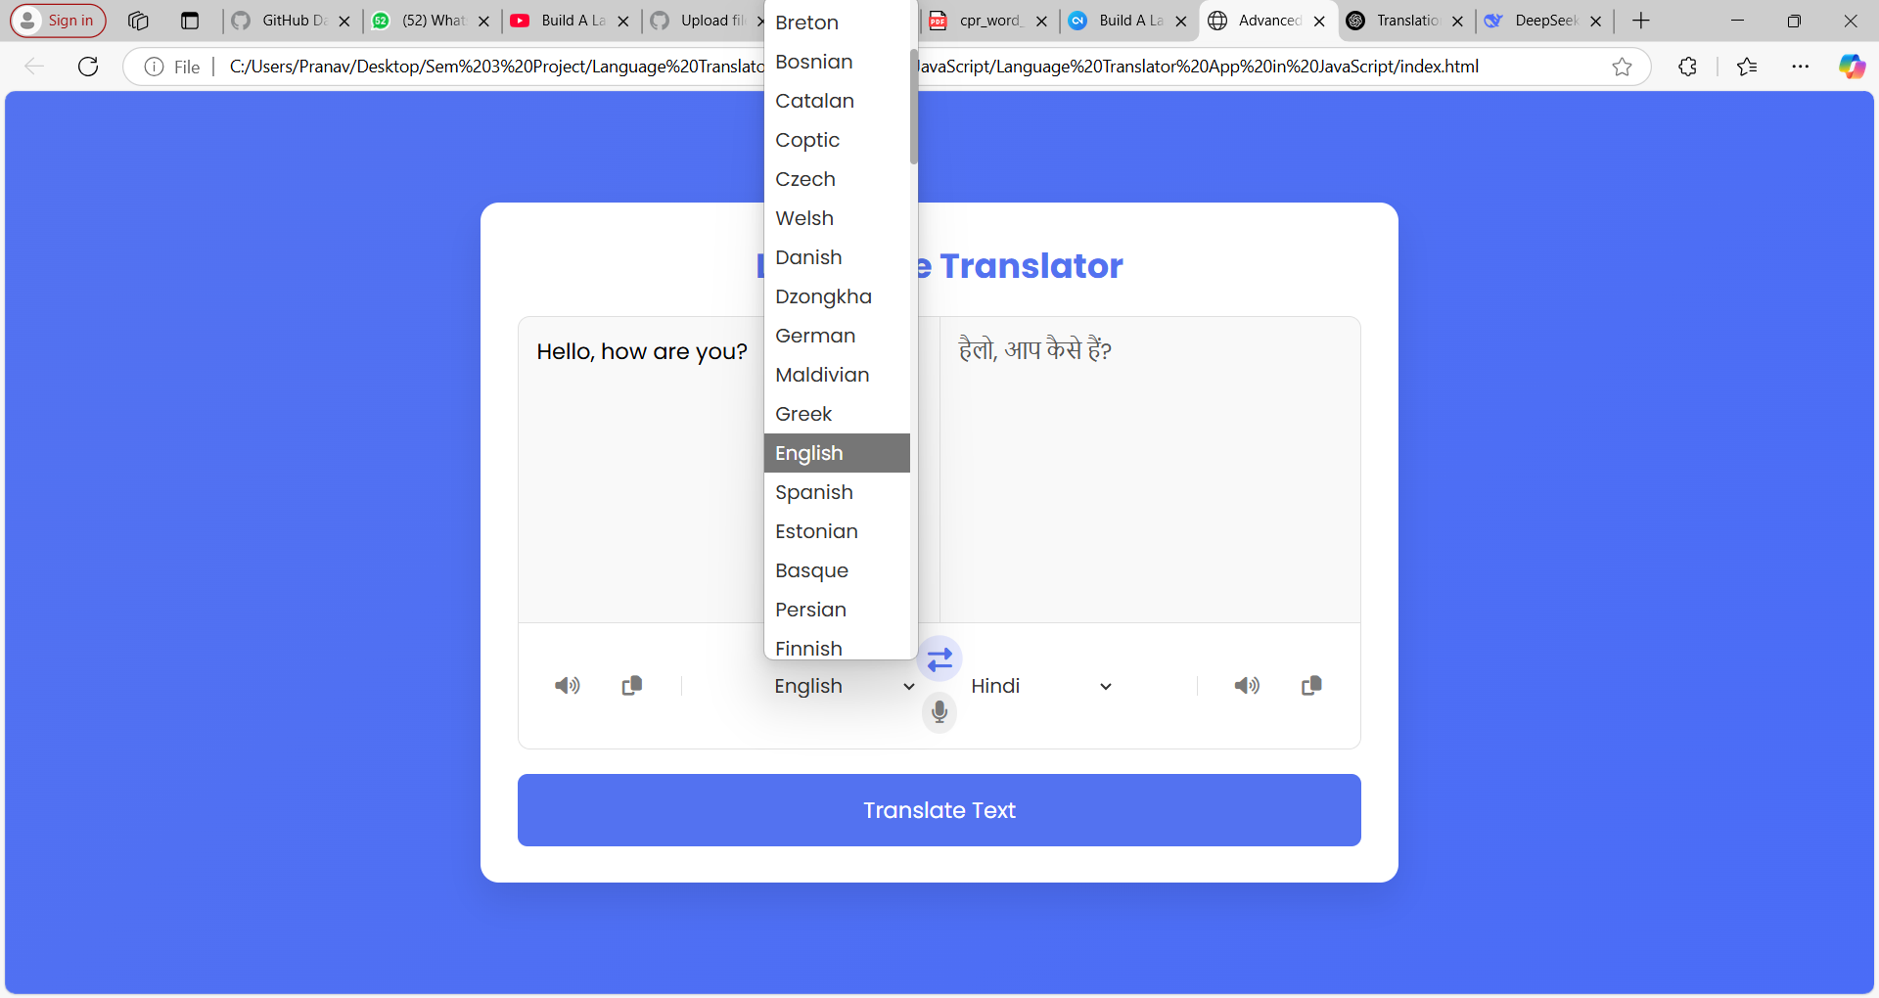
Implementation

Slide 11
Conclusion
• Successfully developed a functional language translator application combining Java and Python technologies
• Demonstrated the ability to break down language barriers through AI/ML techniques
• Created an intuitive user interface for seamless cross-language communication
• Achieved our objective of fostering global connectivity through technology
Key Takeaways:
✓ Practical implementation of natural language processing
✓ Integration of multiple programming languages
✓ Valuable experience in AI/ML application development
✓ Foundation for future enhancements like voice translation and additional languages

Slide 12
references
1. Bird, S., Klein, E., & Loper, E. (2009). Natural Language Processing with Python. O'Reilly Media.
2. Jurafsky, D., & Martin, J. H. (2020). Speech and Language Processing (3rd ed. Pearson).
3. Google Cloud Translation API Documentation
4. MyMemory Translation API Technical Specifications
5. Oracle Java Documentation (2023)
6. Python Software Foundation. (2023). Python 3.11 Documentation

Slide 13
thank you

